Slide 1
Care Act 2014
Sally Latham
Oxfordshire Dignity and Dementia Champions’ Network meeting
11th December 2014

Slide 2
An overview of some of the free learning and development materials available…
Skills for Care
Social Care Institute for Excellence (SCIE)
National Dignity Council

Slide 3
Skills for Care
Care Act 2014
A short cartoon video
http://www.skillsforcare.org.uk/Standards/Care-Act/Care-Act.aspx

Slide 4
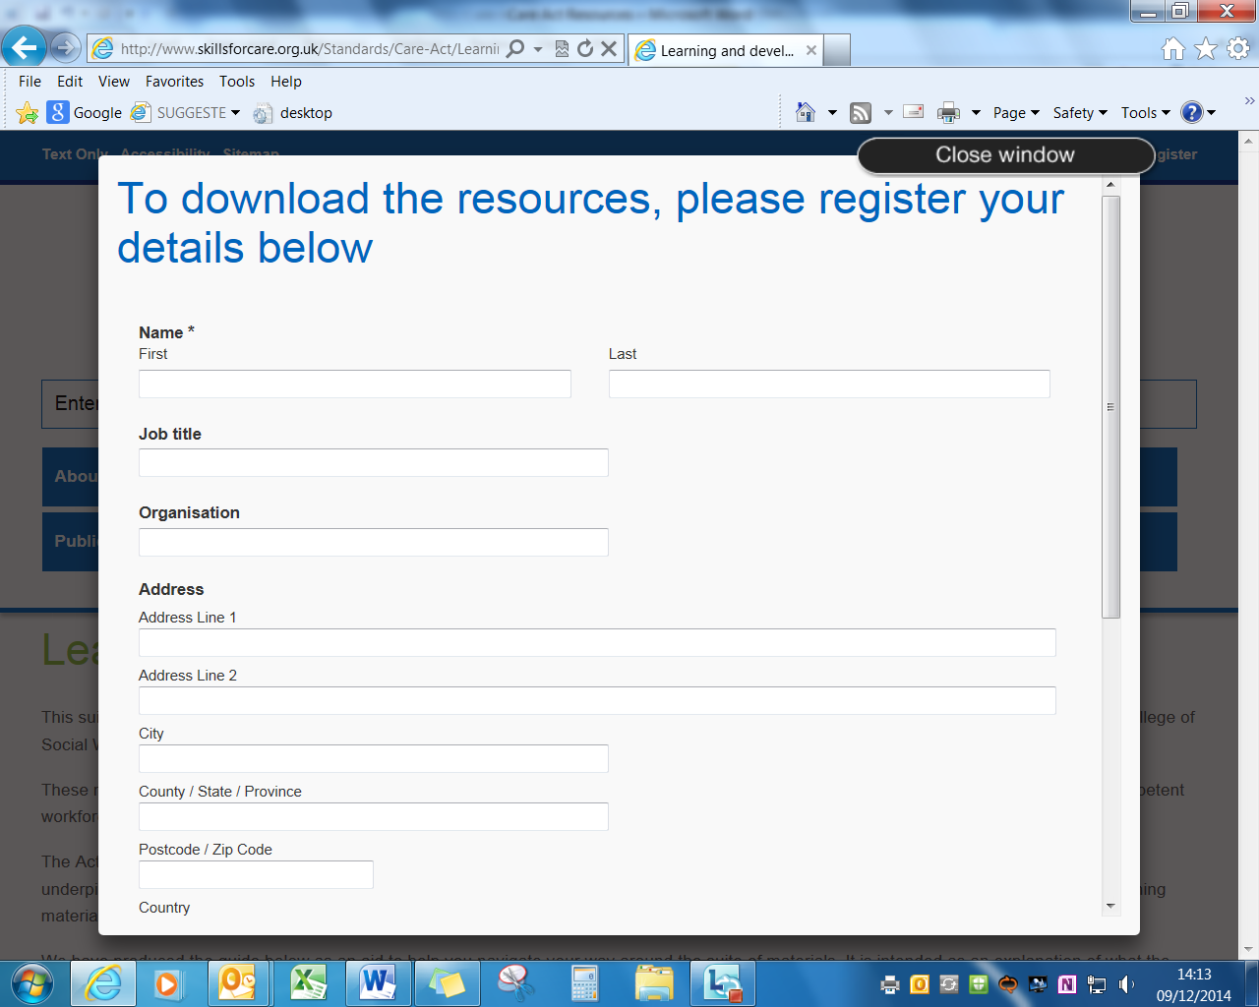
Skills for Care

Slide 5
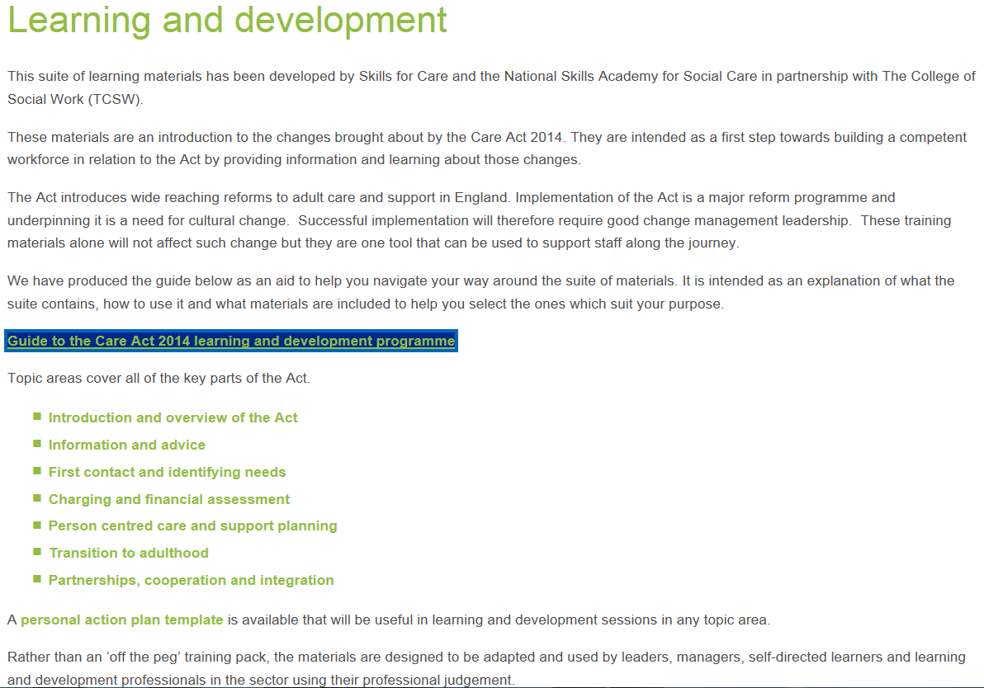
Notes:
Skills for Care

Slide 6
Social Care Institute for Excellence (SCIE)
Care Act 2014 - animated video
http://www.scie.org.uk/care-act-2014/
The Care Act basics
http://www.local.gov.uk/web/guest/care-support-reform/-/journal_content/56/10180/6530936/ARTICLE

Slide 7
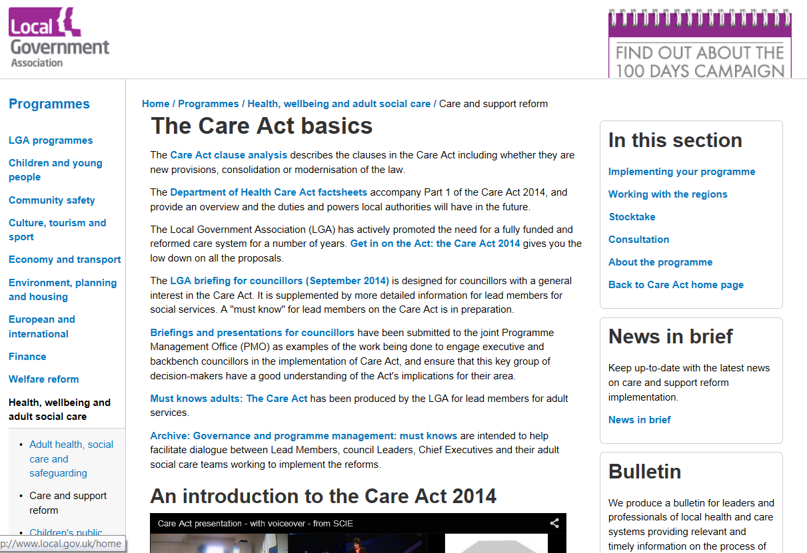
Notes:
SCIE

Slide 9
National Dignity Council
Dignity Action Day Resources
http://www.dignityincare.org.uk/Dignity_in_Care_events/Dignity_Action_Day/What_is_Dignity_Action_Day/?parent=7036&child=8277
Draft Dignity Audit tools – feedback welcomed
http://www.dignityincare.org.uk/Resources/Type/resource/?cid=8272

Slide 10
Thank you

